Slide 1
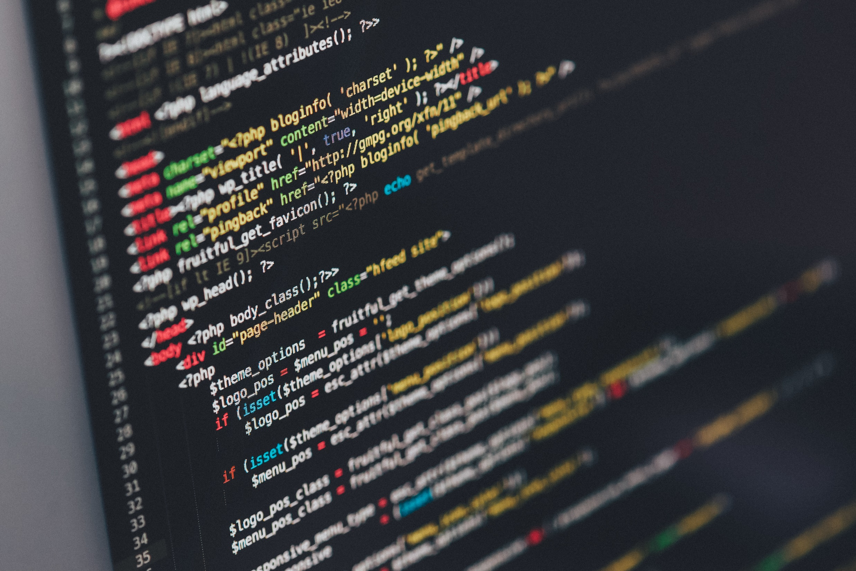
Web/Python Programming
웹/파이썬 프로그래밍

Slide 2
Today
Designing algorithms
Searching for the smallest values
Timing the functions

Slide 3
Algorithm
An algorithm is a set of steps that accomplishes a task.
Program
Function
Task
Function
Function
Notes:
알고리즘 = 일을 처리하기 위한 것. 내가 하고자 하는 일은 여러가지 분해 가능한 일로 쪼개지게 돼 있다.
쪼개져있는 절차들이 정해진 시간에 호출되어 사용됨.

Slide 4
Top-down design: An algorithm writing technique
Programmers often write algorithms in English + mathematics, and then translate it into Python.
In mathematics, the first versions of “proofs” often handle common cases well, but fail for odd cases: mathematicians look for counterexamples.
An implementation may look reasonable, but will contain bugs: Programmers test their code as they write it.

Slide 5



Searching for the smallest values
How to find the index of the smallest items in an unsorted list
Find, remove, find
Sort, identify minimums, get indices
Walk through the list
Suppose we have data showing number of humpback whales sighted off the coast of British Columbia over the past ten years:
Notes:
1. Min이라는 메소드 쓰기
2. 정렬 시켜 찾기
3. 직접 구현하기

Slide 6
Find, remove, find
Find the indices of the two smallest values?
Find the index of the minimum, and save the first index.
Remove that item from the list.
Find the index of the new minimum item in the list, and save the second index.
Put back the value we removed and adjust the second index to account for that reinsertion.
Notes:
min사용해서 찾기..
두번쨰로 작은건?? Min으로 찾아 제거하고 다시 min사용

Slide 7
Sort, identify minimums, get indices
Find the indices of the two smallest values?
Sort the list, and get the two smallest numbers.
Find their indices in the original list.
Notes:
sort해서 두번째 인덱스 가져오기.

Slide 8
Walk through the list
Find the indices of the two smallest values?
Examine each value in the list in order
Keep track of the two smallest values found so far
Update these two values when a new smaller value is found
Notes:
for문 돌리기.

Slide 9
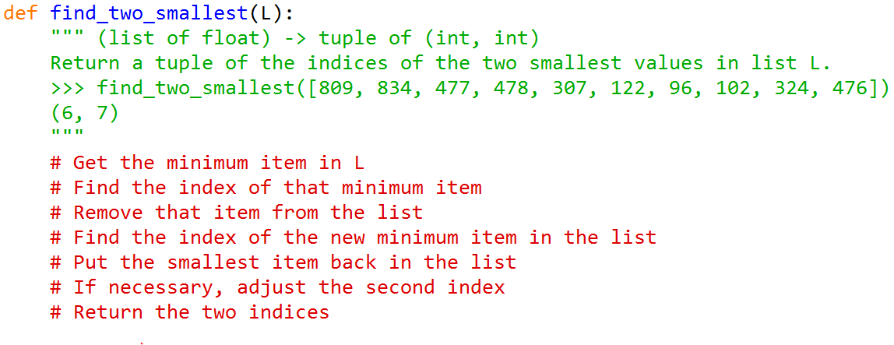
Find, remove, find

Slide 10
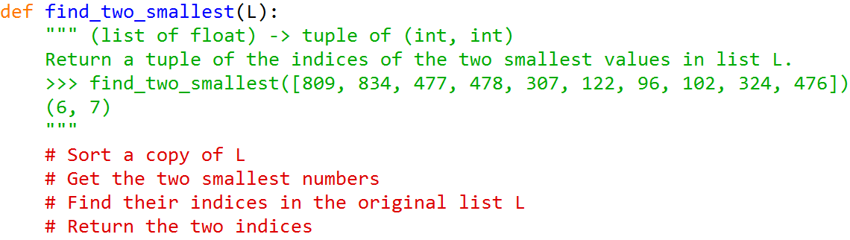
Sort, identify minimums, get indices

Slide 11
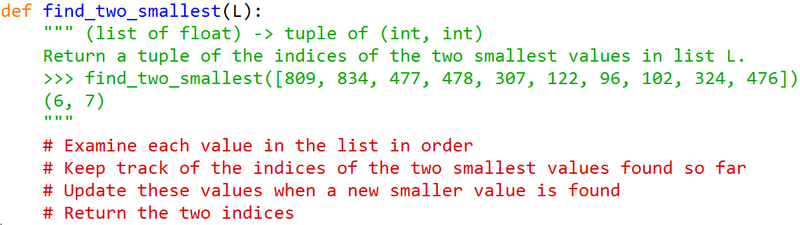
Walk through the list

Slide 12
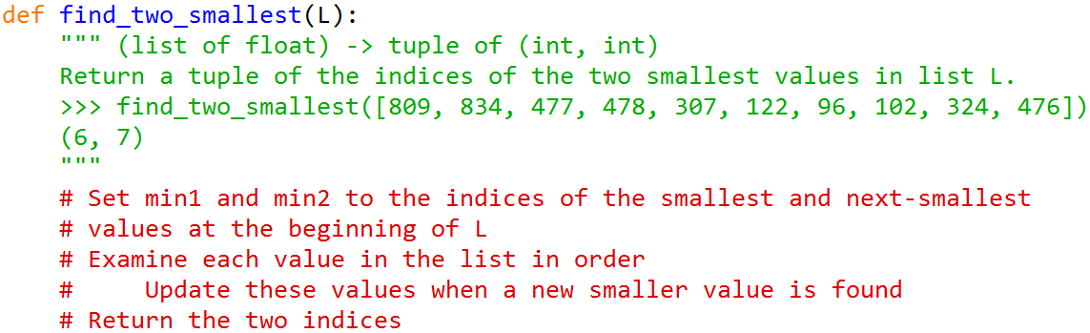
Walk through the list

Slide 13
Timing the functions
Profiling a program
Time: how long it takes to run
Space: how much memory it uses
Fast programs are more useful than slow ones
Programs that need less memory are more useful than ones that need more memory
One way to time how long code takes to run
Notes:
적은 메모리와 적은 시간..

Slide 14
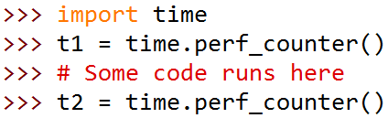
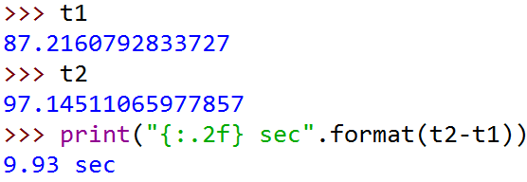
Timing the functions: example
Three find_two_smallest functions
We will use those functions to find the two lowest values in a list on 1400 monthly readings of air pressure in Darwin, Australia, from 1882 to 1998.
Module time contains perf_counter function, which returns a time in seconds. We call it before and after the code we want to time and take the difference to find out how many seconds have elapsed.

Slide 15


Timing the functions: example
Not much difference!!
Simplicity or clarity > speed
But what if we want to process millions of values instead of 1400?

Slide 16
Summary
The most effective way to design algorithms is to use top-down design, in which goals are broken down into subgoals until the steps are small enough to be translated directly into a programming language.
Almost all problems have more than one correct solution. Choosing between them often involves a trade-off between simplicity and performance.
The performance of a program can be characterized by how much time and memory it uses. This can be determined experimentally by profiling its execution. One way to profile time is with function perf_counter from module time.

